Slide 1
Wide area networks (WANs)
LANs are physical networks connecting devices that are close together
Typically, all under the operator’s control and ownership
WANs are physical networks connecting devices that are far apart
Typically, significant portions are not completely under operator’s control or ownership
Illegal and impractical to run cabling across town or around the countryside
Telephone companies (telcos) have been doing that work for over 150 years
They have lots of wires already in place both across town and around the countryside
Wires pass through Rights of Way (ROWs) secured by the telco

Slide 2
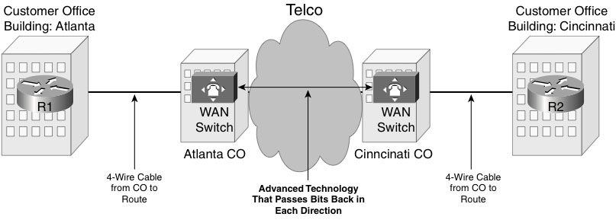
WAN links
Physical media
Conceptually, similar to a crossover Ethernet cable
But doesn’t adhere to Ethernet protocols
Routers at each end
Each with a serial interface connecting to the WAN link
Serial WAN link is typically a 4-wire circuit leased from a telco
Aka: leased line, leased circuit, point-to-point link, WAN link, or serial link
Functionally equivalent to a single cable, even though it’s probably comprised of many separate cables and switching devices
Connecting to a 4-wire circuit often requires the telco to run a cable from your site to their nearest central office (CO)
That cable connects a router at your site to a WAN switch in the CO
Telco assumes responsibility for moving bits among all of its WAN switches as needed
So a similar setup between a router at another site and a WAN switch in a different CO completes the WAN link
Notes:
Figure 14-3 from Computer Networking First-Step by Wendell Odom (ISBN: 1587201011) Copyright © 2013 Cisco Systems, Inc. All rights reserved.

Slide 3
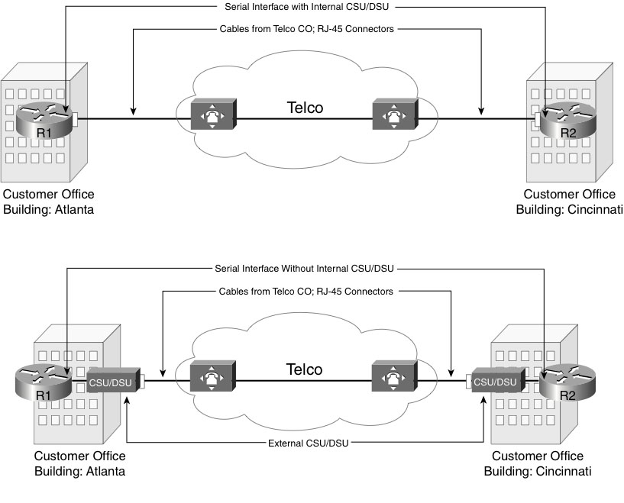
WAN speeds
WAN links typically support different transmission speeds than Ethernet
Generally, multiples of 64 Kbps
24 x 64 = 1.544 Mbps (T1 line)
Speed is specified within the lease and configured into both the WAN switch and the serial interface
The part of the interface that governs the speed is the Channel Service Unit/Data Service Unit (CSU/DSU)
May be either internal or external
Notes:
Figure 14-4 from Computer Networking First-Step by Wendell Odom (ISBN: 1587201011) Copyright © 2013 Cisco Systems, Inc. All rights reserved.

Slide 4
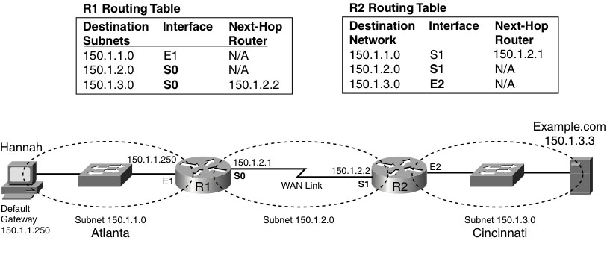
Routing over a WAN link
As far as a router is concerned, a serial interface to a WAN is just another interface
The WAN is just a separate subnet
So routing is handled just like it would be for any other subnet
The WAN is just entered into the routing table like any other subnet
Notes:
Figure 14-5 from Computer Networking First-Step by Wendell Odom (ISBN: 1587201011) Copyright © 2013 Cisco Systems, Inc. All rights reserved.

Slide 5
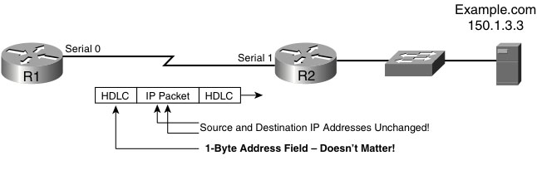
Forwarding over a WAN link
WAN links typically use technologies other than Ethernet
There are many data link layer protocols that might be used
High-level Data Link Control (HDLC)
Point-to-Point Protocol (PPP)
Have a frame check sequence (FCS) field in their trailer
Have a destination address field in their header
But since there are only two ends to the link, this field is generally not used
Likewise, there’s no need for ARP or a similar service
Everything sent by one modem is received by the other
Note that WAN links are shown as “lightning lines” in diagrams
Notes:
Figure 14-7 from Computer Networking First-Step by Wendell Odom (ISBN: 1587201011) Copyright © 2013 Cisco Systems, Inc. All rights reserved.

Slide 6
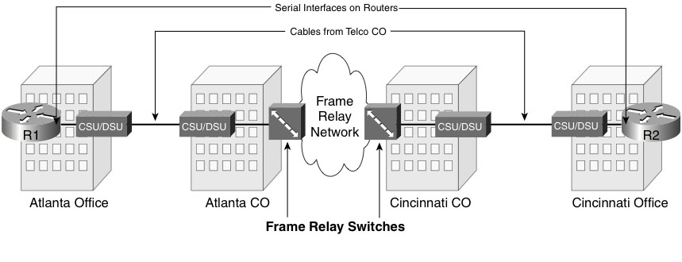
Frame Relay
Lets multiple routers communicate, each using only a single WAN link
A frame relay network is conceptually similar to an Ethernet switch
Several routers can be connected to their local COs via WAN links and communicate with one another as if connected to an Ethernet switch
Notes:
Figure 15-1 from Computer Networking First-Step by Wendell Odom (ISBN: 1587201011) Copyright © 2013 Cisco Systems, Inc. All rights reserved.

Slide 7
Frame Relay service
Routers connect to Frame Relay switches in COs
Provides a Frame Relay service
Telco becomes a Frame Relay service provider
Frame Relay is a set of OSI Layer 2 protocols
Layer 1 services are provided by the individual WAN links
Those WAN links are called access links in Frame Relay terminology
Several Frame Relay switches and the connections among them form a Frame Relay network
Operation governed by Frame Relay protocols
Originally formulated by a vendor consortium called the Frame Relay Forum
Later formalized by ITU and ANSI

Slide 8
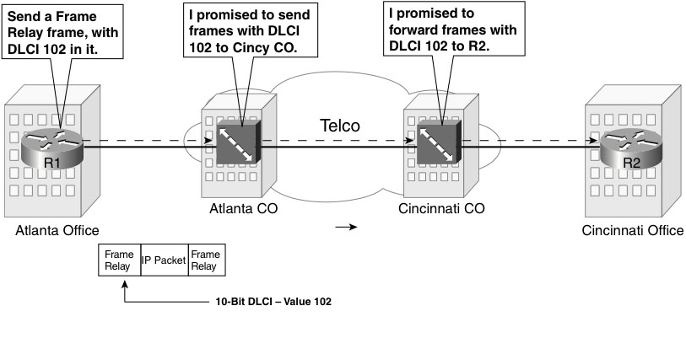
How Frame Relay works
Essentially, it’s a promise to forward frames from one router to one of several other routers
Encapsulation – add header and trailer to build a frame
Header contains a data-link connection identifier (DLCI)
10-bit number that identifies destination router
No automatic learning of addresses, each switch must be manually configured
Trailer contains a frame check sequence (FCS) field for error detection
Notes:
Figure 15-2 from Computer Networking First-Step by Wendell Odom (ISBN: 1587201011) Copyright © 2013 Cisco Systems, Inc. All rights reserved.

Slide 9
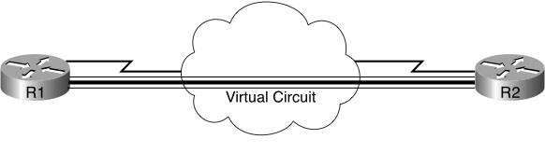
Virtual circuits (VCs)
Telco provides DLCI values for all contracted destinations
Customer’s router can reach any of them through its single WAN link to a Frame Relay switch
Equivalent to having a physical 4-wire circuit to each contracted destination with only one actual connection
Hence the term virtual circuit
Diagrammatically, shown as a thick line surrounded by thinner lines
Since each VC is permanently configured within the Frame Relay network, they’re commonly called permanent virtual circuits (PVCs)
Notes:
Figure 15-4 from Computer Networking First-Step by Wendell Odom (ISBN: 1587201011) Copyright © 2013 Cisco Systems, Inc. All rights reserved.

Slide 10
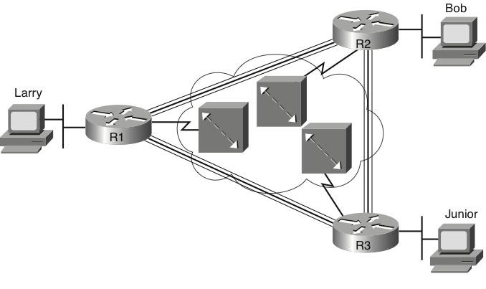
Full mesh vs. partial mesh
If all routers in a Frame Relay network are connected via PVCs, it’s a full mesh
Otherwise, it’s a partial mesh
Notes:
Figure 15-5 from Computer Networking First-Step by Wendell Odom (ISBN: 1587201011) Copyright © 2013 Cisco Systems, Inc. All rights reserved.

Slide 11
Advantages of Frame Relay networks
Cheaper than several WAN links
Less than half the hardware and cabling required
Each router would need a serial interface and a CSU/DSU
Each pair of routers needs a separate leased cable
Faster than a WAN link
Telco contracts a specific committed information rate (CIR) for each PVC
Guaranteed minimum bandwidth
Imposed as logical, not physical, limit
Physical links within network must operate at higher rate, called the access rate
If a router exceeds its CIR on a given PVC and the Frame Relay network is not already overloaded, the router will get more than its CIR
Since this happens more often than not, the average speed of the Frame Relay network generally exceeds that of a single equivalent WAN link, which runs only at its configured speed
Can be treated as a separate subnet to simplify routing
Routers learn each others DLCIs by exchanging Inverse ARP messages over the PVC connecting them
Notes:
Figure 15-4 from Computer Networking First-Step by Wendell Odom (ISBN: 1587201011) Copyright © 2013 Cisco Systems, Inc. All rights reserved.

